Slide 1


Credit Card Fraud
Anomaly Detection
Alan Danque Spring Semester GitHub Portfolio:
https://adanque.github.io/
https://github.com/adanque/Anomaly-Detection

Slide 2
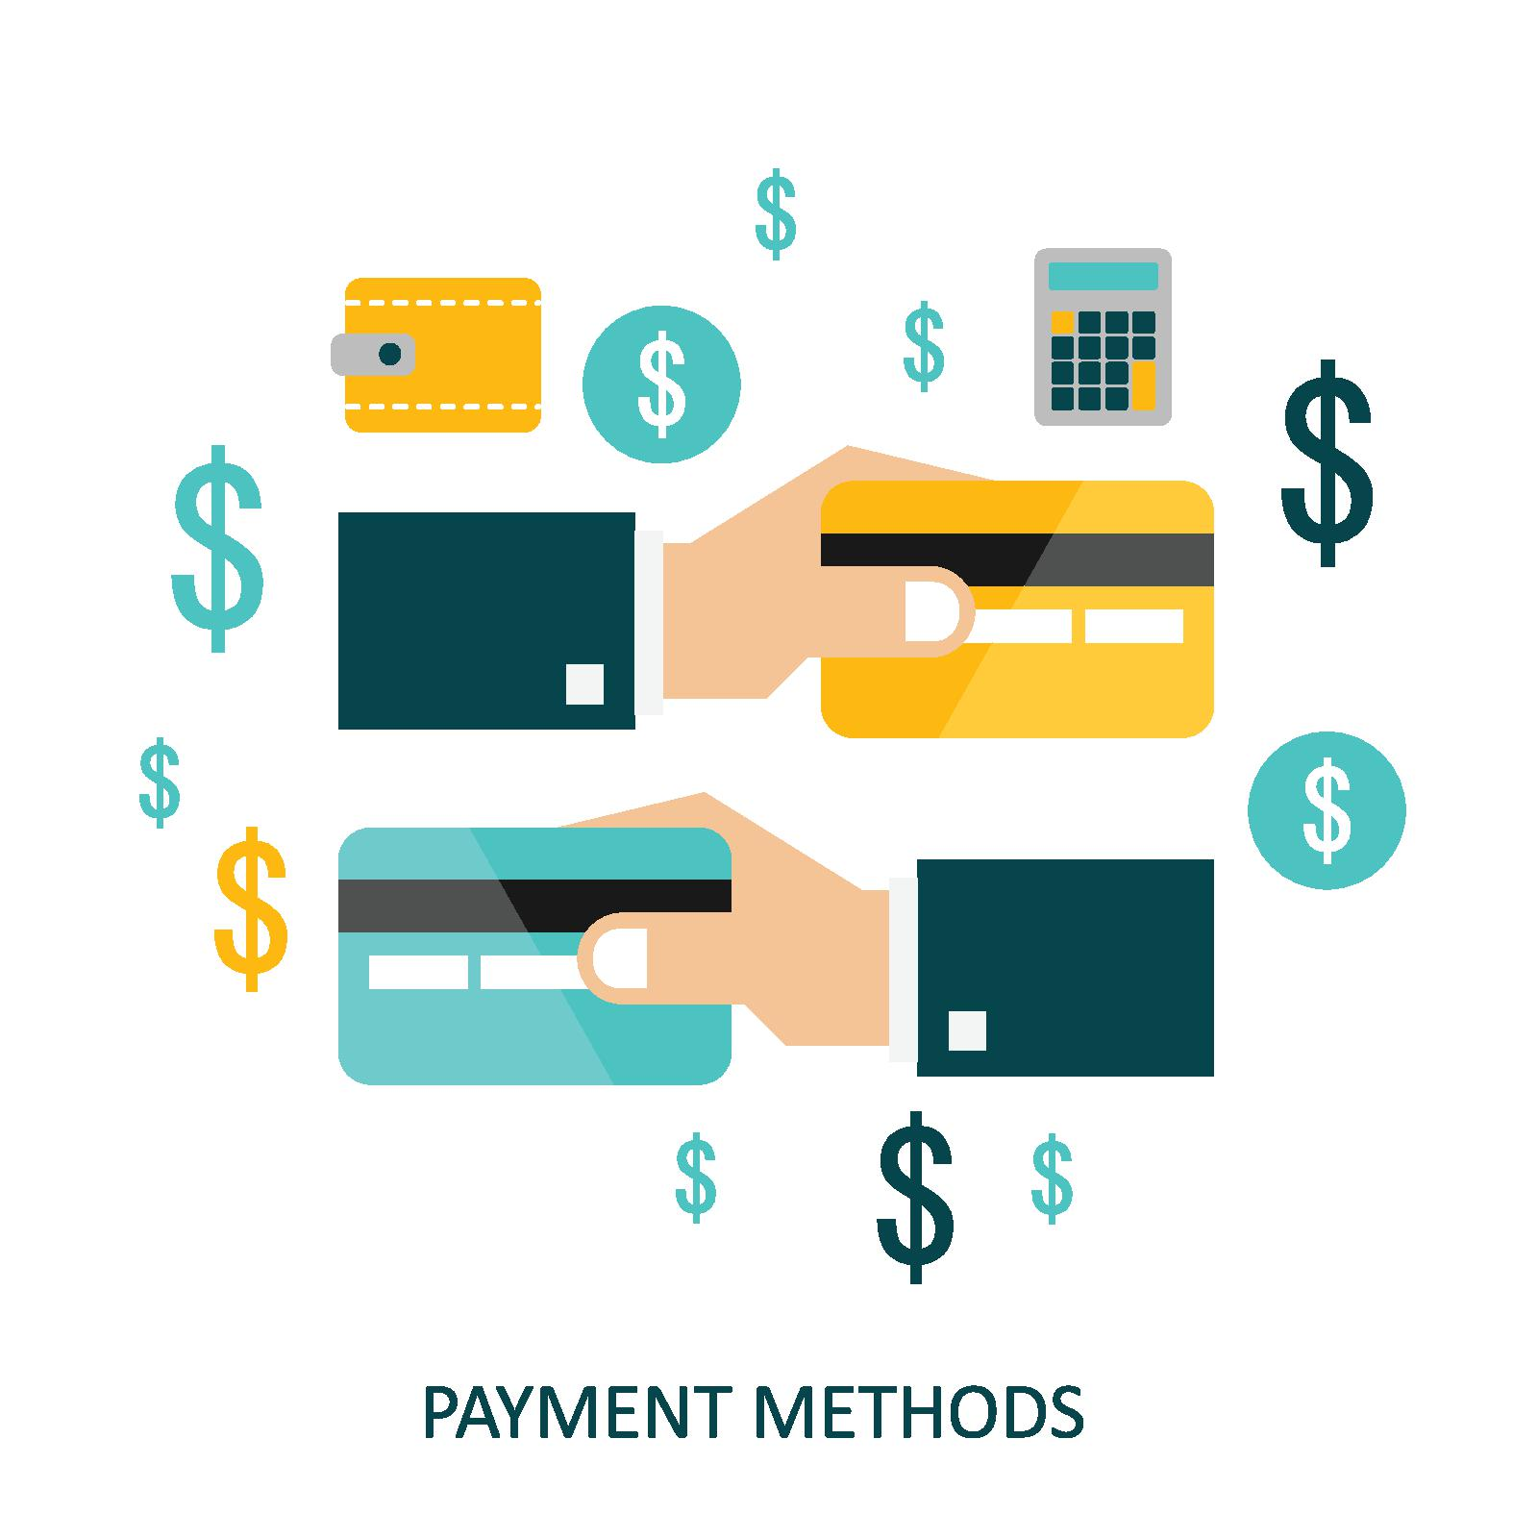
Paying by credit card is the most convenient means of payment online and in person.

Slide 3

While paying by credit is one of the most convenient payment methods, it’s also vulnerable to theft and therefore fraud.

Slide 4
Anomaly detection to identify credit card fraud
Anomaly detection can help identify fraud before it devastates a person's credit.
It analyses expected behavior.
Detects anomalies by discovering outliers or abnormalities.
In this project, I walk through how credit card anomalies can be identified as fraudulent using a Kaggle dataset to train a predictive model.
Datasource: https://www.kaggle.com/mlg-ulb/creditcardfraud

Slide 5
Methods:
I used the Pandas profiling library to assist with generating graphs for exploring the distribution of my data and identify possible fields that need cleaning or removal.
I then generated plots to visualize the distribution of my data, PCA & Inertia plots to understand the grouping, correlation matrix to review relationships of my dataset’s fields, boxplots to analyze the outliers in my dataset and scatter plots to review the distributed spread of my normal and fraudulent classes.
Split my dataset using the sklearn RepeatedStratifiedKFold for model training.
Use the algorithms: Local outlier factor, One Class SVM, Isolation Forest and Elliptic Envelop to attempt to make predictions. Then to further increase specificity over sensitivity, I used pyCaret to help identify the best performing model.
Review and measure the performance of my predictive model using a Precision Recall, F1 Score, MCC, Kapp, r2 score, MAE, MSE, RMSE and the time to train.
Test and verify predictions of my model using test data.
Visualize the Decision Tree of my resulting model using scikit learn’s export_graphviz for model explain ability.

Slide 6
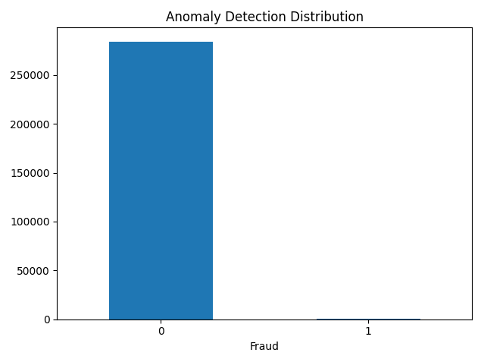
Imbalanced Churn Dataset The dataset used to train the model contains: 492 fraudulent transactions in a dataset of 284,807 records.

Slide 7
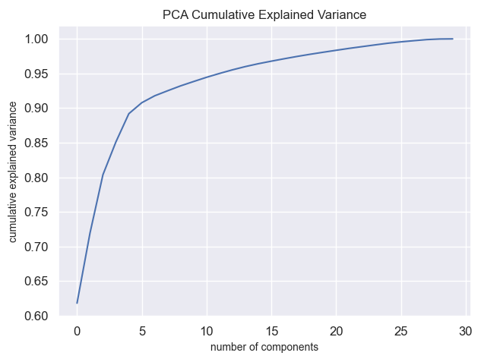
The above indicates that 4-5 components can explain 90% of data variances.

Slide 8
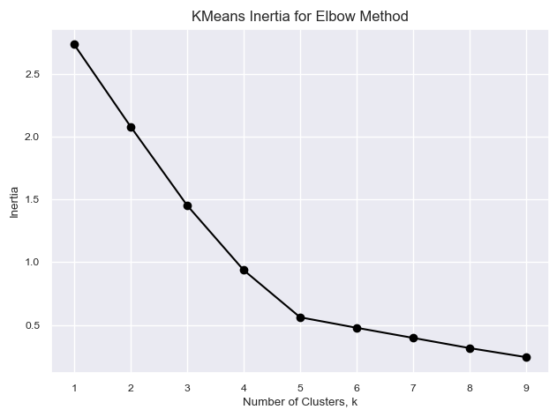
The k means inertia elbow graph above indicates that my dataset can be optimally clustered into 4-5 groups.

Slide 9
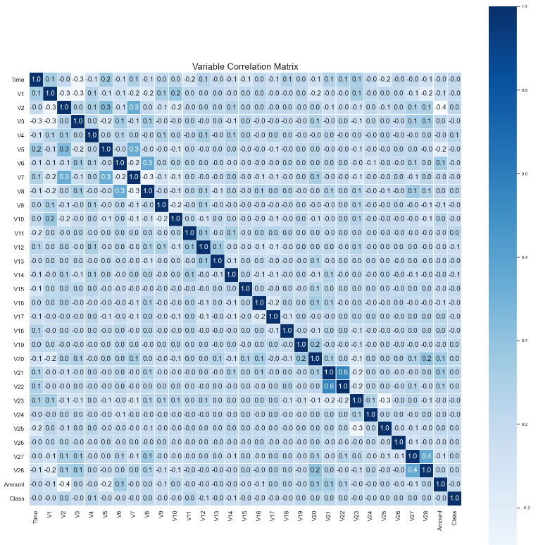
I found that if I export the correlation matrix to csv and then sort the feature correlation values by Class.

Slide 10
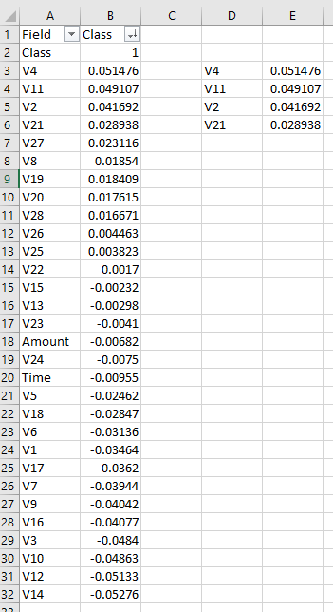
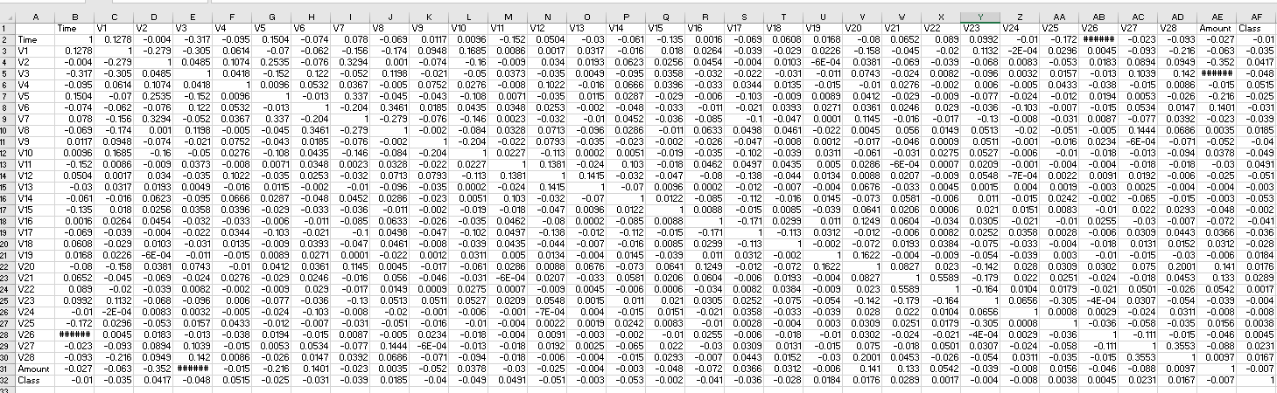
I can easily obtain the top 4 correlated features I can use in my predictive model.
Note: The number 4 was obtained from the PCA Cumulative Explained Variance above.

Slide 11
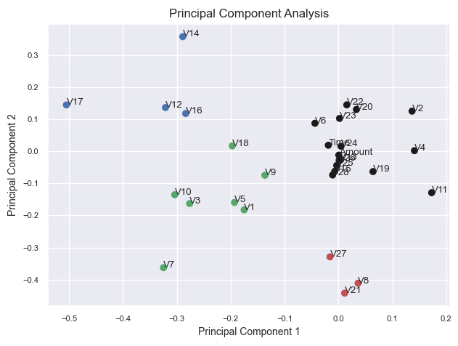
Notice the proximity indicating correlations between the clustered features marked in black and one in the red group. This aligns with the 4 features identified earlier per V2, V4, V11 and V21.

Slide 12
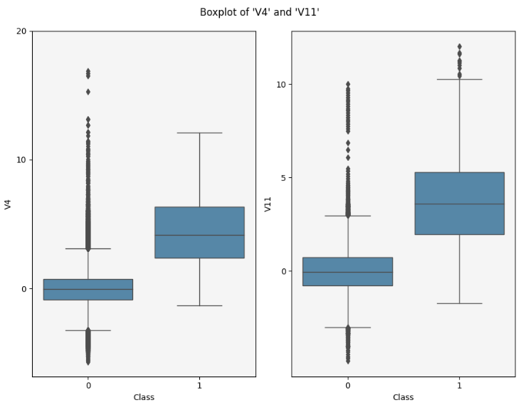
Notice the easy to find outliers on the V11 boxplot for Churn class of 1.

Slide 13
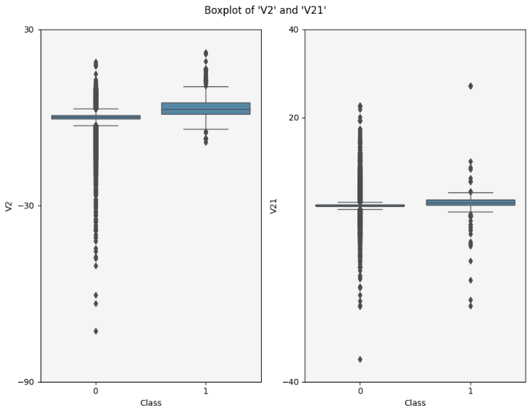
The above graph also shows an interesting amount of outlier for component V21.

Slide 14
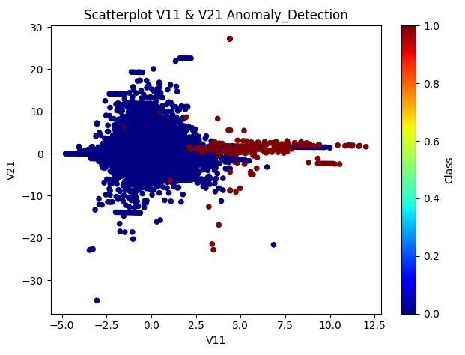
The above scatter plot displays some specific indicator in red - that can help assist with possible churn customers.

Slide 15
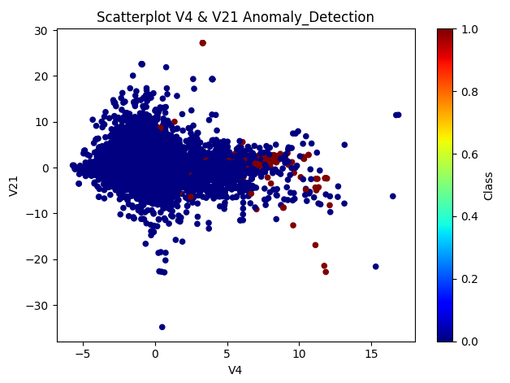
The above scatter plot displays some specific indicator that can help assist with possible churn customers.

Slide 16
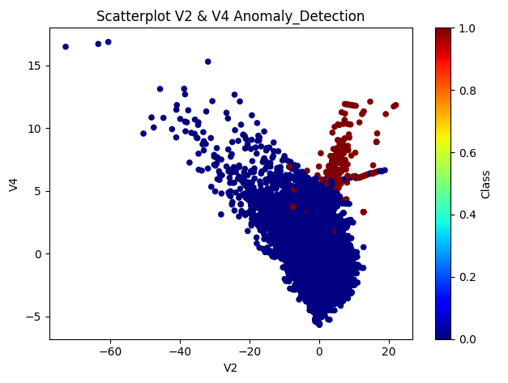
The above scatter plot does a better job of identifying likely churn customers as noted in the red markers.

Slide 17
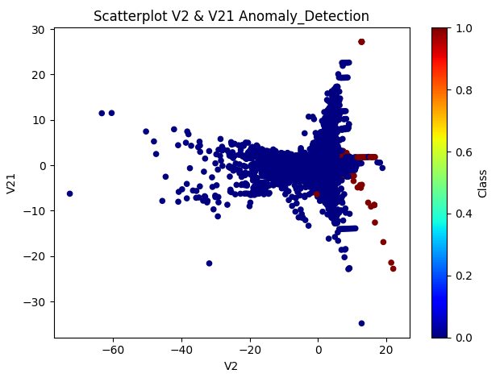
The above scatter plot displays some specific indicator that can help assist with possible churn customers.

Slide 18
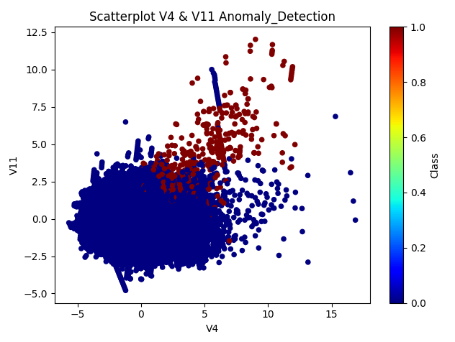
The above scatter plot appears to do the best job of identifying likely churn customers. Notice the obvious red grouping outside of those who do not churn in blue.

Slide 19
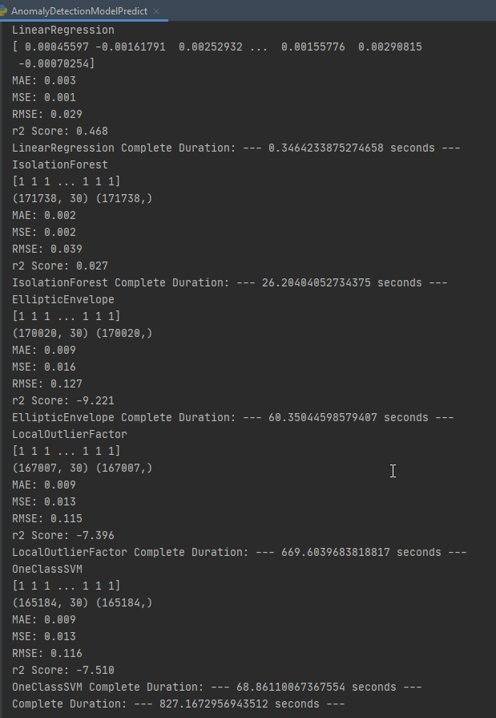
Model Algorithms
For my project I had earlier planned to test out 5 algorithms for my model.
These algorithms included:
Linear Regression
Isolation Forest
Elliptic Envelope
Local Outlier Factor
One Class SVM
The metrics I used to review the results of these algorithms include: MAE, MSE, RMSE and r2 Score.

Slide 20
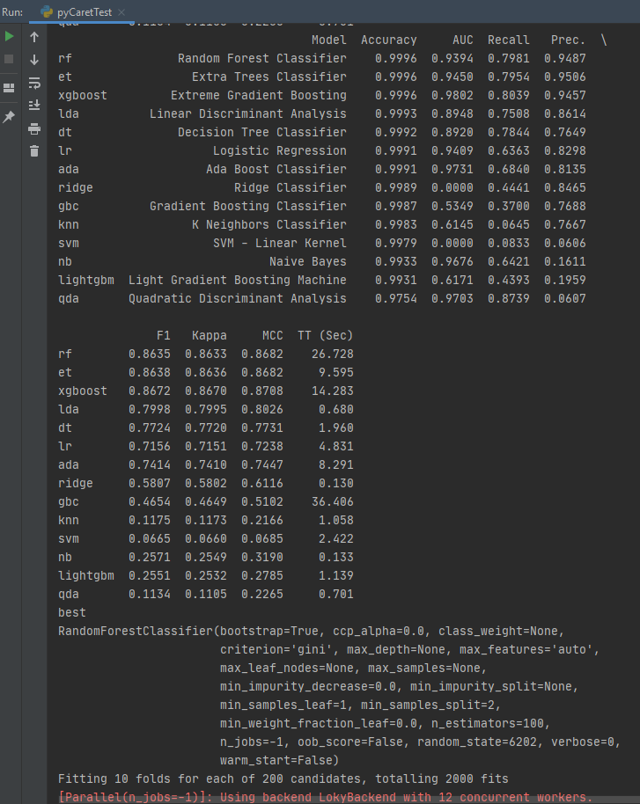
PyCaret Model Review
PyCaret evaluations between algorithms:
Logistic Regression
K Nearest Neighbors
Extreme Gradient Boosting
Decision Tree Classifier.
Ridge Classifier
Extra Trees Classifier
Random Forest Classifier
And more

Slide 21
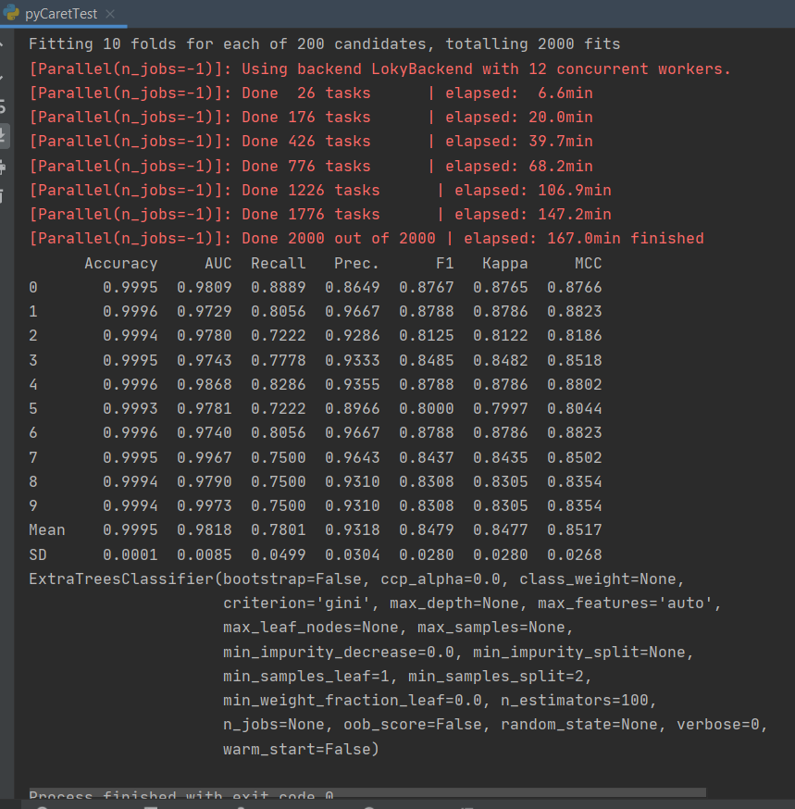
PyCaret evaluation has identified that the best algorithm for my project’s model is “Extra Trees Classifier”

Slide 22
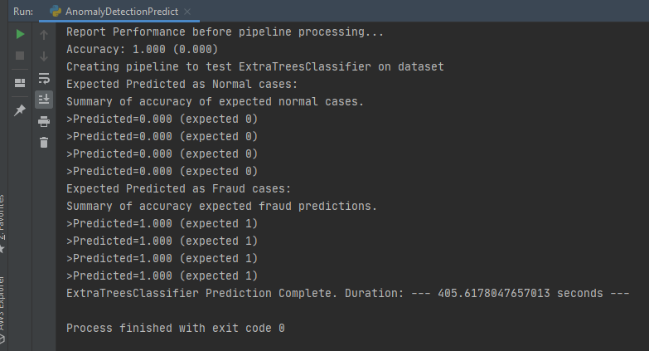
Prediction Pipeline Validation: Using ExtraTreesClassifier, each prediction was completed as expected with the correct result using random test data.

Slide 23
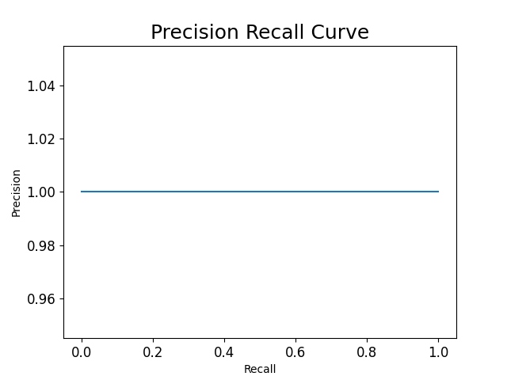
The above Precision Recall Curve plots how well the prediction vs test values matched per TP/True Positives, FP/False Positives and FN/False Negatives. It was measured using Sklearn’s average_precision_score metric function.

Slide 24
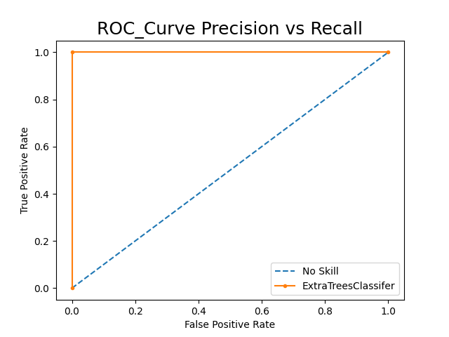
Since the purpose of my project is to identify false positives which is more important than to false negatives (missing fraudulent transactions), this project is focused more on specificity and therefore precision over sensitivity. This is reflected on my precision and recall plots.

Slide 25
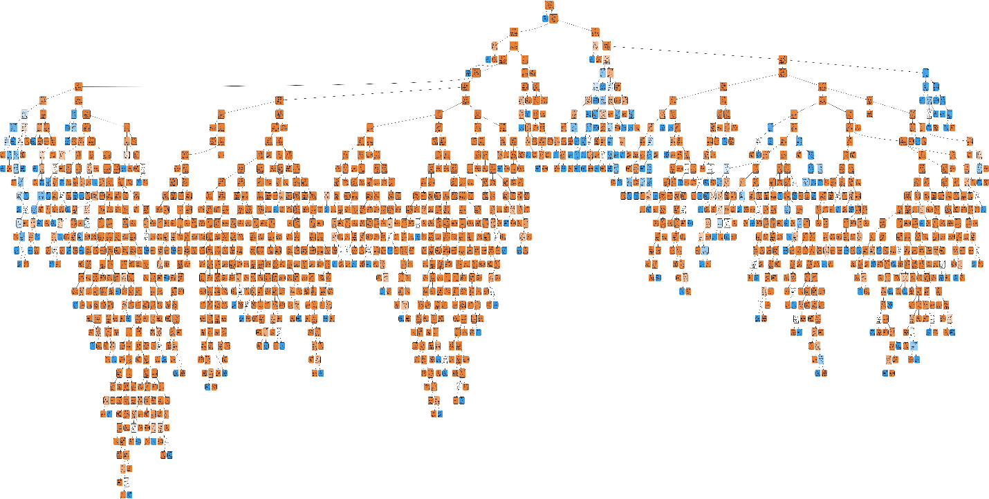
Full Visualization of the decision tree of my model.

Slide 26
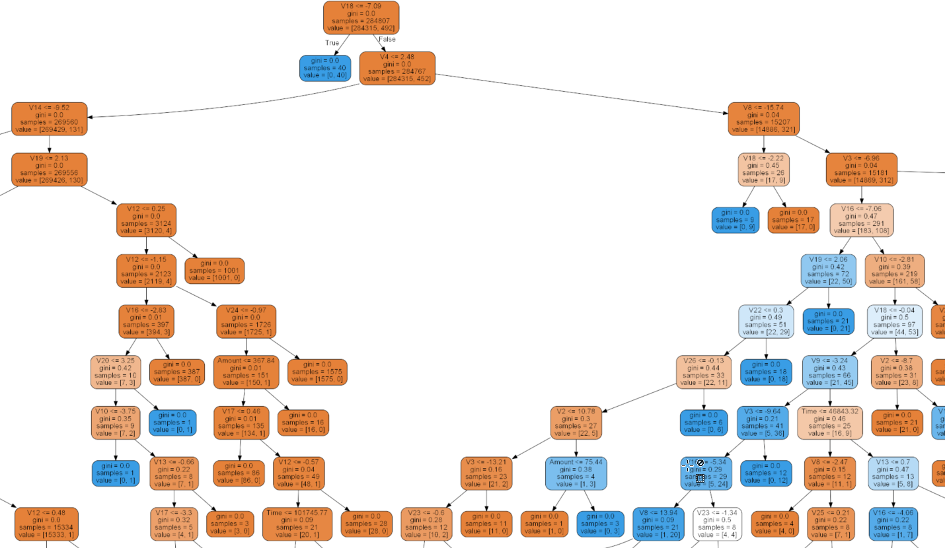
Zoomed in view of the center of the decision tree.

Slide 27
Conclusion
Credit card fraud is an extremely important issue as it devastates a person’s credit, violates their identity and privacy of their personal information. Here we learned that we can detect this type of anomaly to be sensitive to the variations in the features of one’s credit usage. And build a predictive model that has an accuracy greater than 99%.

Slide 28
Thank you for your time!

Slide 29
References:
Cicchetti, D.V., & Sparrow, S.A. (1981). Developing criteria for establishing interrater reliability of specific items: applications to assessment of adaptive behavior. American Journal of Mental Deficiency, 86(2), 127-137.
Landis, J.R., & Koch, G. G. (1977). The measurement of observer agreement for categorical data. Biometrics, 15-174.
Fleiss, J.L. (1981). Statistical methods for rates and proportions (Second Edition). New York: Wiley.

